Slide 1


SOCIAL MONEY MANAGEMENT TOOL
By GROUP-1 [CSE-F]:-
ABHIMANYU VALSARAJAN [CB.EN.U4CSE21601]
CHARAN REDDY Y [CB.EN.U4CSE21610]
GOUTHAM REDDY VVS [CB.EN.U4CSE21666]
VIVEK S [CB.EN.U4CSE21668]
YELLINA SRIBHARGAV [CB.EN.U4CSE21670]

Slide 2
PROBLEM STATEMENT:-
Design a social money management tool that allows a group of friends to keep running tabs on who owes who, how much, and for what. Users collaborate to decide on how to split past and current bills such as taxi fares or restaurant bills.

Slide 3
DESCRIPTION ABOUT THE PROJECT
The admin will create a group and add members using email id and mobile number.
Invitation links will be sent by email with instructions to access the application and login info.
There will be 2 parts to this application-
i- Debt - The friend lending the money can add information about it.
ii- Bills Of Group Activities- The admin can add bill of group activities and choose the people who participated in it. The share of the bill will be reflected on the group members’ profile.
Every 10 days members of the group will be reminded to pay their dues.
On the profile page the user can see his/her financial commitments. The user can also view payment options.
SMMT Score on the profile which increases on prompt payment of dues.

Slide 4

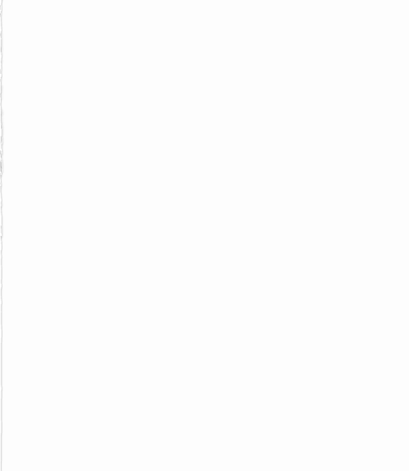
FUNCTIONS:-
ADMIN -ABHIMANYU
CHECK -BHARGAV
BILL -ABHIMANYU
DEBT -CHARAN
PAYMENT PAGE -BHARGAV
SMMT SCORE -CHARAN
RECURRING -GOUTHAM
EXPENSE TRACKER -VIVEK
REMINDER –GOUTHAM
PROFILE PAGE:-
–ABHIMANYU, BHARGAV

Slide 5
ADMIN
Overview-
Allows a person to create a group.
Allows the admin member to add members to the group.
Making changes to the structure of the group.
C Language Functionalities Used-
1D and 2D Arrays
Strings
For loops

Slide 6
BILL
Overview:
Allows users to add bills from group activities like movie
bills, restaurant bills, etc.
Admin has full control over bills so the chance of misuse is less.
Even if a few members were absent, the option to split accordingly has been added.
C Language Functionalities Used:
2D Arrays.
<string.h> Header File.

Slide 7
DEBT
OVERVIEW:-
Allows users to add data about the lending and borrowing
activities.
This function Is used to calculate the EMI and the total debt amount.
FUNTIONAS USED:-
Power function
Strings
If loops

Slide 8
CHECK
CHECK FUNCTION IS USED TO CHECK THE LOGIN AND SIGNUP CREDENTIALS OF A USER TO ENTER THE APPLICATION.
FUNCTIONS USED:-
ARRAYS- RECEIVED CREDENTIALS ARRAYS FROM ADMIN FUNCTION.
STRCMP- TO COMPARE TWO STRINGS.
STRCPY- TO ASSIGN ONE STRING TO A STRING VARIABLE.
SRAND,RAND,TIME- TO GENERATE RANDOM NUMBERS TO USE IT AS AN OTP.
TWO SUB-PARTS:-
LOGIN- TO LOGIN
CHECKS THE ENTERED CREDENTIALS WITH THE STORED CREDENTIALS.
SIGNUP- TO REGISTER
STORES THE NEW ENTERED CREDENTIALS IN THE CREDENTIALS ARRAY.

Slide 9
PAYMENT PAGE
PAYMENT PAGE FUNCTION IS TO PAY BILL PAYMENT AND DEBT PAYMENT.
DISPLAYS ALL THE BILL DETAILS AND DEBT DETAILS.
FUNCTIONS USED:-
ARRAYS:- RECEIVED BILL INFORATION AND DEBT INFORMATION FROM BILL FUNCTION AND DEBT FUNCTION.
SRAND,RAND,TIME- TO GENERATE RANDOM NUMBERS TO USE IT AS AN OTP.
RETURNS THE VALUE OF X WHICH IS MANIPULATED DURING THE TRANSACTION PERIOD TO USE IT IN THE SMMT FUNCTION.

Slide 10
SMMT SCORE
OVERVIEW:-
SMMT score is a measure of individuals ability to pay back the borrowed amount.
This function helps the people who lend the money.
Clubs will be awarded according to SMMT score.
The SMMT score will be set to 250 as default.
FUNTIONALITIES USED:-
If loops

Slide 11
EXPENSE TRACKER
This code is used to make the user aware of his/her expenses in their daily life. It helps the user to keep track of their expenses and how efficient they are in their expenses. The code takes the input of the no: of items bought by the user and totals the amount and compares it to the capped amount.
If the money spent is more than the capped amount , then a message appears which shows that your expenses are high, or if the money is spent efficiently , a ‘keep it up’ message appears.

Slide 12
RECURRING PAYMENT
Recurring payment is a feature where user are allow to schedule future payments using payment information.
How to set up Recurring payment
The user chooses to pay on a recurring basis.
Then user to set up schedule future payments and payment structure.
At the point , recurring payment begins to takes place.
FUNCTIONALITES OF RECURRING PAYMENT :-
The recurring payment can be set up using NESTED IF –ELSE STATEMENT.
String , IF Statements are used to made recurring payment.

Slide 13
REMAINDER
Remainder helps the user to remind to pay un paid payments.
HOW TO SET UP REMAINDER
- Check whether the user paid the bill or not.
If payment is not done helps the user to remind to pay the payment.
Remind until the payment is done
FUNCTIONALITES used in remainder:-
<string . h> header file is used remainder.
IF statement is used to check payment.
while loop is used to remind the payment.

Slide 14
PROFILE PAGE
DISPLAYS ALL THE DETAILS OF USER.
FUNCTIONS:-
RECEIVING INFORMATION FROM OTHER FUNCTIONS.
DETAILS OF USER:-
USERNAME
USERMAIL
USERPASSWORD
BILL INFORMATION
DEBT INFORMATION
SMMT SCORE
RECURRING PAYMENT INFORMATION

Slide 15
THANK YOU
By GROUP-1 [CSE-F]:-
ABHIMANYU VALSARAJAN [CB.EN.U4CSE21]
CHARAN REDDY Y [CB.EN.U4CSE21]
GOUTHAM REDDY VVS [CB.EN.U4CSE21]
VIVEK S [CB.EN.U4CSE21]
YELLINA SRIBHARGAV [CB.EN.U4CSE21670]

